Slide 1
CTD Advanced Training – Day 1
Combinatorial Test Design (CTD)

Slide 2
At the end of this course you learn
Attributes & Values
Levels of Interaction
Restrictions
Modeling Pattern
Hands on above using IBM FOCUS Tool.

Slide 3
Overview
Combinatorial Test Design (CTD) - Is a technique that avoids dealing with all combinations by IBM FOCUSing on the smaller number of combinations that are extracted from the Cartesian product likely to expose defects. It consists of modeling by identifying high risk combinations with levels of interactions.
The output is the production of a test suite in which, all high risk combinations are covered, and each test script is as unique as possible from all other tests.
The effectiveness of CTD as an optimization technique has been established in different types of software, industries, test phases and domains.

Slide 4
When is CTD appropriate?
Best candidates have a significant number of attributes with relationships that determine the application/system execution flow.
New projects that satisfies above.
Large on-going development programs and projects.
Notes:
New projects
Project in requirement phase
Estimated high level of test cases
Desire for quality and good code coverage
Using CTD to create a model for what needs to be tested
Large ongoing development programs and projects
New release of a large ongoing program
A large project with a high amount of test cases
Projected schedule crunch

Slide 5
Attributes & Values
Attribute: A point of key variability. An element in the testing requirements that causes different navigation paths or interactions through the code.
Values: Different states of an attribute, that can be grouped as logical partitions, boundaries or negative states and are represented as strings, integers, or Booleans
How do we find these?
  Harvest the information by reviewing documents such as use cases and requirements docs.
  Interaction with the client’s Subject Matter Experts (SMEs).
  Once established, review your findings with the SMEs.
  In many cases these are found also using existing test cases (as one of the few artifacts that exist in practice)
Notes:
Lets Open a Toy model to explain with example, Shipping Shopping Model

Slide 6
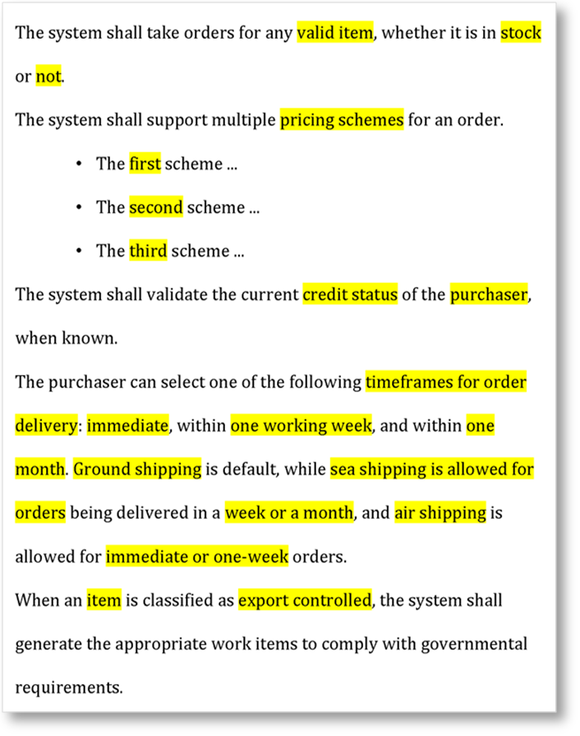
Challenges in manual test design
How many are 'enough'?
How do we know which combinations to choose?
Writing test cases manually will introduce redundandancy and possibly gaps..
Notes:
In traditional test planning, the answer to “how many tests are enough” is usually “as many as I have time to write.”
When test cases are hand-written, we tend to create test cases with copy and paste.
Each time we paste, we tend to change only one or a couple of values for each test case.
The result is a test solution in which each test case is very similar to its predecessors and successors.
Let’s assume that we had time to create 115 test cases for this specification ... though we rarely create 115 test cases per page of specifications!

Slide 7
Sample Manual Test Scenarios
Verify that for an item in stock we can place an order.
Verify that for an item not in stock we can not place an order.
Verify that for an invalid item we can not place an order.
Verify that an order is placed successfully for Scheme 1.
Verify that an order is placed successfully for Scheme 2
Verify that an order is placed successfully for Scheme 3.
Lets Complete the remaining test scenarios in the given requirement.

Slide 8
Identifying elements of the test
What are the points of variability- Attributes?
What are their values?
Can multiple Attributes’ value can be tested together?
What is the logical relationship among attributes?
Notes:
This specification refers to the following attributes:
Item validity ("valid")
In-stock status ("in stock", "not")
Pricing schemes ("first", "second", "third")
Delivery time frame ("immediate", "one week", "one month")
Shipping ("ground", "sea", "air")
Customer credit status (“known”)
Export control status ("export controlled")
This specification implies:
Item validity ("not valid")
Customer credit status (“unknown”)
Results of customer credit check ("approved", "denied")
Export control status ("not export controlled")
Shipping destination (foreign, domestic)
Putting these together gives us these attributes and values:
Item validity ("valid", "not valid")
In-stock status ("in stock", "not")
Pricing schemes ("first", "second", "third")
Delivery time frame ("immediate", "one week", "one month")
Shipping ("ground", "sea",. "air")
Customer credit status (“known”, "unknown")
Results of customer credit check ("approved", "denied")
Export control status ("export controlled", "not export controlled")
Shipping destination (foreign, domestic)

Slide 9
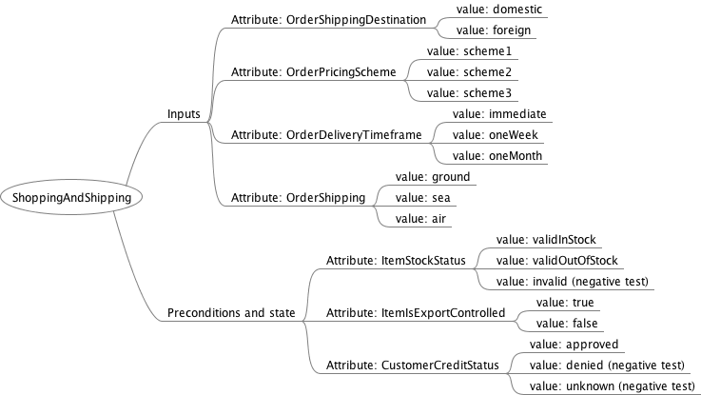
Mind Maps

Slide 10
Hands On
Lets make a group:-
    ETL testing,
    API / Middleware testing and
    Web based testing
Lets Identify Few attributes for the requirement that you have got.

Slide 11
Levels of Interaction
Pairwise testing: For each pair of values in a system, test all possible combinations of those values.
Levels of Interaction: Number of variables involved in a computation at the same time. Pairwise testing is Level 2 interaction.
In practical scenarios selecting right level of interaction is highly critical from testing prospective this gives the quantifiable level of risk being carried.
Notes:
Describe in real life that generally levels of interaction are not that simple it is usual to have 2/3 way models split by attributes, etc. Discussion point how difficult is this to do manually and how easy with the tool.

Slide 12
Levels of Interaction Continued…
Level 1 interaction:
  A bug exists in ground shipping
Level 2 interaction:
  A bug exists in ground shipping with delivery time of one week
Level 3 interaction:
  A bug exists in ground shipping, one week delivery, and export controlled items
Level 4 interaction:
  A bug exists in ground shipping, one week delivery, export controlled items shipped to foreign addresses
  The bug exists in the combination of input values but not in any part of it (i.e., it requires all possible combination values to appear together in the test)
Notes:
Hands on, on defining coverage requirements. (for good path)

Slide 13
Hands On
Level of integration
Create and Analyze the differences with 2 and 3 level of integration.
2

Slide 14
Restrictions
Restrictions are rules that determine which value combinations are included and which are excluded from the model.
Excluded combinations will NEVER appear in the tool outcome.
Restrictions are generally created on the basis of business rules or system rules that explicitly exclude the combination from a system, but this must be carefully assessed so that we do not remove valid combinations of values within attributes
Notes:
It is important to define restrictions very carefully. While you should avoid missing restrictions because you do not want to include tests that do not make sense, you must also ensure that you do not remove combinations that should be tested. You should avoid writing restrictions that exclude combinations that should be included in the test plan, because those overreaching restrictions lead to unintended coverage gaps.
Explain on Derived Exclusions.

Slide 15
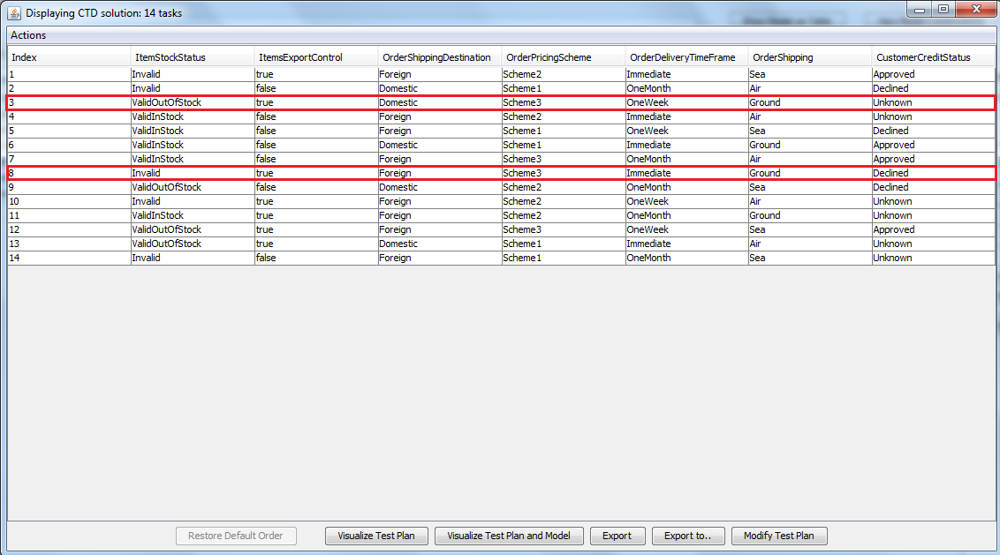
Why are Restrictions Needed?
Exclude impossible or irrelevant value combinations from the model

Slide 16
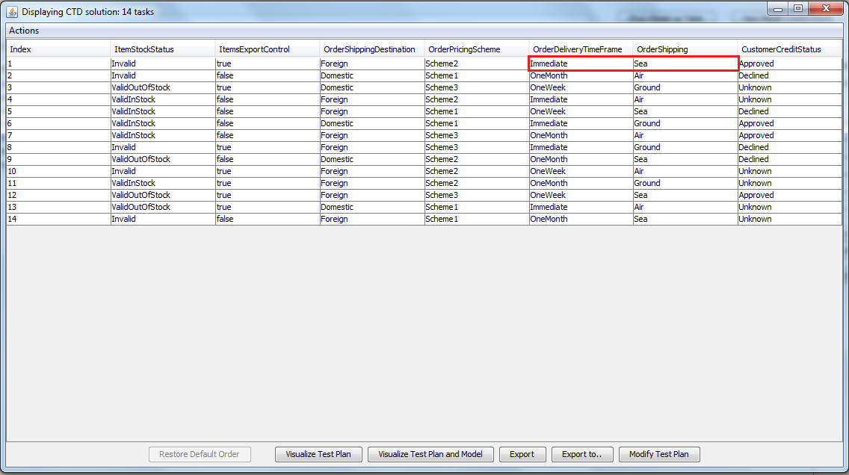
Why not just skip invalid combinations?
Notes:
Some people might think... "I will just skip the tests that are invalid". For example, you could take the CTD result presented in the previous modules, and simply skip all tests where the Order Shipping is Sea and the delivery schedule is Immediate because Immediate delivery is not possible by Sea.
Assume you remove the problematic test highlighted in the figure above. Indeed, there are no tests with Immediate delivery through Sea any more. However, this test covered many other pairs as well, which are valid and should be covered. Specifically, legal pairs are now uncovered:
It is highly not recommended to simply skip tests that contain invalid combinations, because these tests may also cover unique legal combinations. By skipping tests, you run the risk to lose the 100% n-wise coverage that CTD guarantees.
This is why you need to state in advance what are the illegal combinations (in the form of restrictions), so CTD will take this information into account and not produce tests that contain invalid combinations.

Slide 17
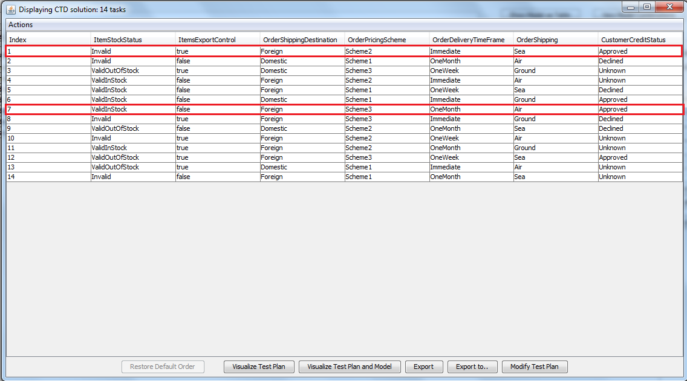
Using restrictions to ensure coverage
Analyze your CTD tool outcome.
  Can all scenarios logically occur?
  Define restrictions to eliminate illogical tests.
Notes:
Consider the online shopping system used in the previous two modules. The system has seven parameters or attributes: Item Stock Status, Export Control, Shipping Destination, Pricing Scheme, Delivery Time Frame, Shipping and Customer Credit Status.
Refer to the Test solution in Module 2, where level two interactions with all attributes selected are tested. When you analyze the set of tuples, you will notice that some scenarios could not logically occur. For example, there is no option in the shopping system for Immediate delivery through Sea since sea route does not guarantee immediate delivery. Therefore the test highlighted in the figure cannot be executed. Also, a delivery of One month through the AirCarrier does not make sense. To eliminate illogical tests, you just define restrictions in IBM FOCUS.

Slide 18
How to Define Restrictions in IBM FOCUS
Mark and exclude combinations in the Cartesian Product.
Write explicit conditions on which combinations should be included or excluded.
Notes:
Both ways of restriction creation must be part of hands on.
The Cartesian product exclusions are performed from a projection on a small number of attributes.
Demo on If and IF & only IF Restrictions.

Slide 19
Hands On:
Restrictions
  Projection
  Excluding Combinations
  Cartesian Product
  Editing & Debugging Restrictions
  Derived Exclusions
  Generating CTD outcome
  Adding a restriction may vary the CTD outcome

Slide 20
Modeling Patterns
Optional Attributes
Conditionally-exclusive attributes
Multi-selection
Ranges & Boundaries
Order & Padding
Symmetry-derived order independence
Notes:
Modeling patterns are cases that often repeat in different CTD models of different types and from different domains. There are solutions to translate them into attributes, values, and restrictions.
Here are some modeling patterns:

Slide 21
Optional Attributes
Attributes can sometimes be: Irrelevant, Not Applicable (N/A), or Uninteresting
Online Form Examples:
  Email: valid/invalid (required field)
  Home Address: valid/invalid (optional field)
Solution: Add “N/A” value to attribute in FoCuS
  Corresponds to “data was not entered” in example scenario
Live Demo (FoCuS)
Notes:
Some attributes can sometimes be irrelevant, not applicable, or uninteresting. These are called optional attributes.
Example: A user enters details in an online form:
Email: valid/invalid (Required field)
HomeAddress: valid/invalid (Optional field)
Solution: To capture that HomeAddress is optional, you will add the value notApplicable (or empty) to it.
Assigning this value to HomeAddress means that the corresponding data was not entered.

Slide 22
Conditionally-Exclusive Attributes
Attributes req’d only under certain conditions
Example: Online Shopping model
  Checkbox labeled “billingByEmail”
  Address fields are now disabled – bill is sent via email
Solution: Restrict the model accordingly
  Force home address to “N/A” when billing by email
  Exclude “N/A” when not billing by email
Live Demo (FoCuS)

Slide 23
Multi-Selection
Multiple values of the same attribute can appear together in a single test
Example: A shopping application has products of four types:
  Meat
  Milk
  Fish
  Drinks
If we only specify ONE attribute for these FOUR values, the FoCuS tool can only specify ONE product selection at a time, but the application allows for multiple selection of products
Notes:
Multi-selection occurs when multiple values of the same attribute can appear together in a single test.

Slide 24
Multiple Selection
Solution: Instead of ONE attribute, we will create FOUR of boolean type
Meat: true/false
Milk: true/false
Fish: true/false
Drinks: true/false
NOTE: We must create a restriction that at least one value is selected

Slide 25
Ranges & Boundaries
We can divide values into different ranges that represent different cases
Example: Options to categorize and handle files in a system according to their size
  File size < 1MB
  1 MB < File size < 256MB
  256MB < File size
Solution: Create a “fileSize” attribute with 7 values:
  0
  moreThan0LessThan1
  1
  moreThan1LessThan256
  256
  moreThan256
Notes:
You can divide values into different ranges that represent different cases.
Note that:
The range boundaries represent corner cases.
All ranges and boundary values should be represented in the model and tested.
This is a well-known pattern in data abstraction and categorization methods.

Slide 26
Ranges & Boundaries (cont’d…)
Example 2: User chooses insurance benefits for an updated insurance plan. Some may already exist in his current plan
Solution: Create a “benefits” attribute with 5 values:
  allExisting
  someExistingSomeNew
  allNew
  oneExisting
  oneNew

Slide 27
Modeling Patterns: Order & Padding
Output depends on two inputs
Example:
  Expenses are covered only if both, food & lodging, are claimed
  Note: Claim for food can occur before or after lodging (easy to overlook)
Solution Requires 4 new attributes:
  Food: True/False
  Lodging: True/False
  foodBeforeLodging: True/False/N/A
  paddingBefore: True/False/N/A
  paddingBetween: True/False/N/A
  paddingAfter: True/False/N/A
Notes:
Expenses are covered only if both, food and lodging, are claimed.
Note: The claim for food can occur before that of lodging or after it. This is easy to overlook!
There may be other expense claims before, after, and between food and lodging, or there may be none. This is known as padding.

Slide 28


Slide 29


